Slide 1


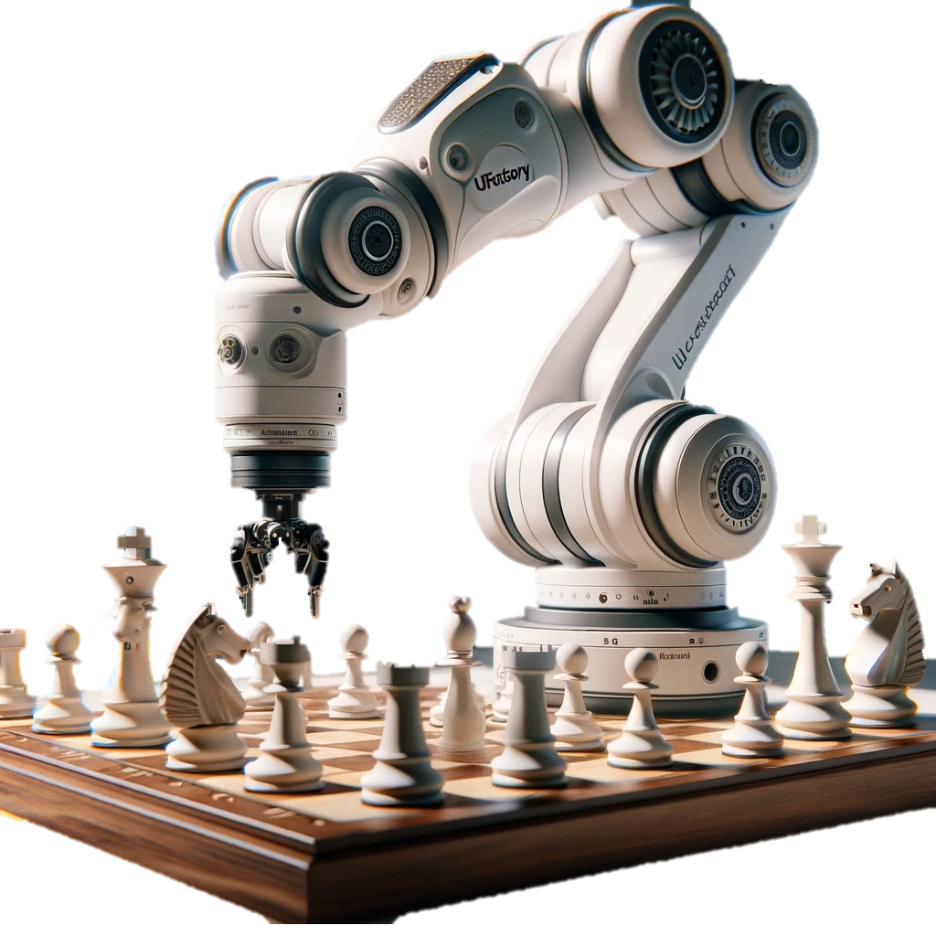
Technion – Israel Institute Of Technology
Department of Electrical and Computers Engineering
CRML LAB
RoboChess: Chess Playing Robotic Arm
Using Image Processing & Computer Vision
Project by: Muhammed Ghanayem & Ahmad Ghanayem
Supervised by: Elisei Shafer
Winter 2023 – Winter 2024

Slide 2
Motivation & Introduction
Recently chess became more popular due:
Social media teaching strategies to beginners
Improvements in chess engines algorithms
The ability to play chess virtually against anyone any where.
Recent technologies pushed robotics field more into the spotlight
We decided to implement an interactive robotic chess experience

Slide 3
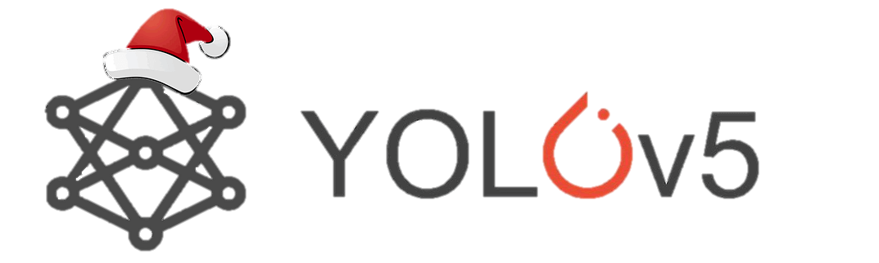
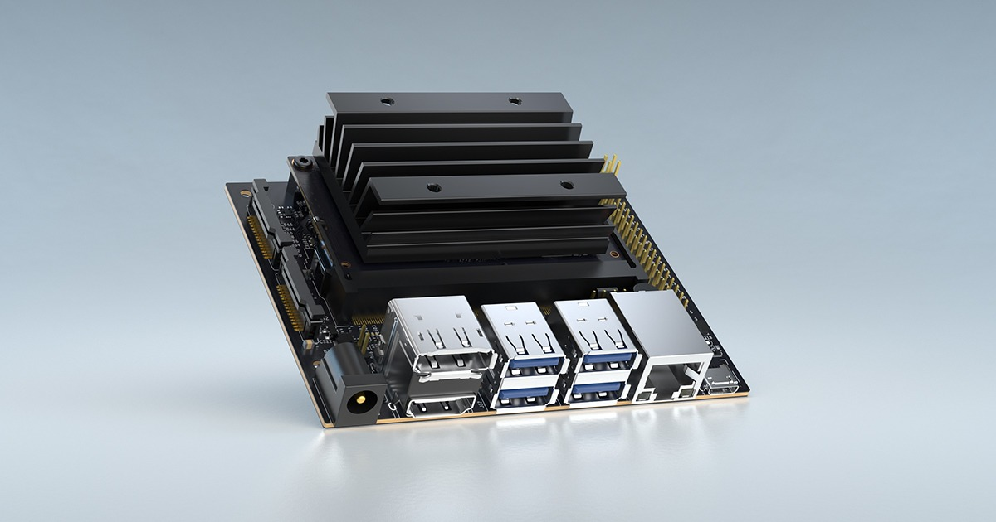
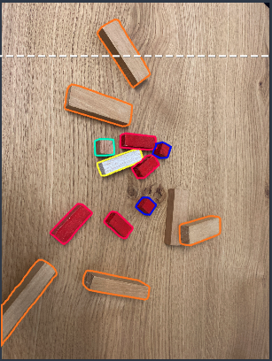

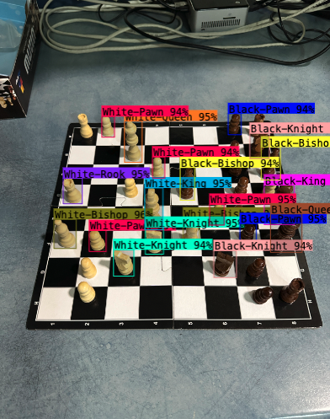
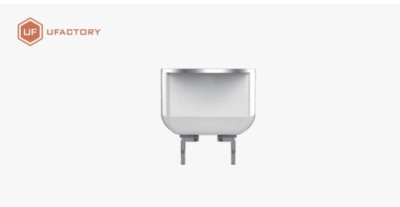
How it started

Slide 4
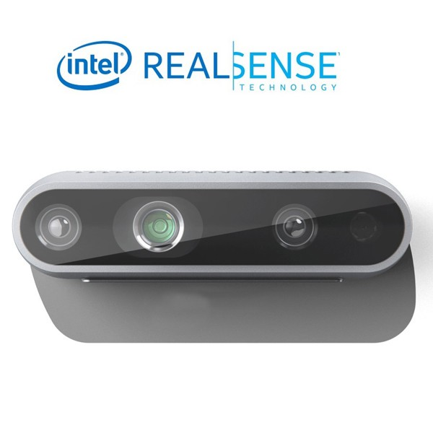
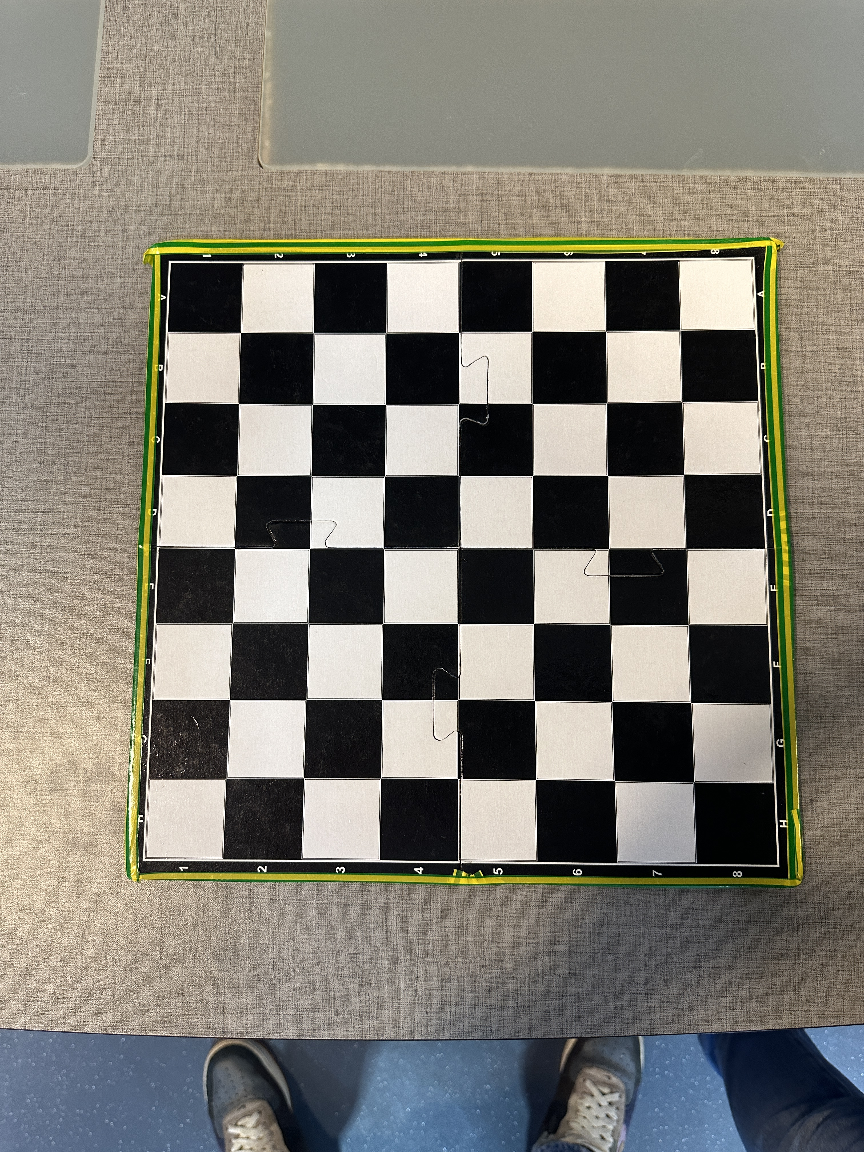
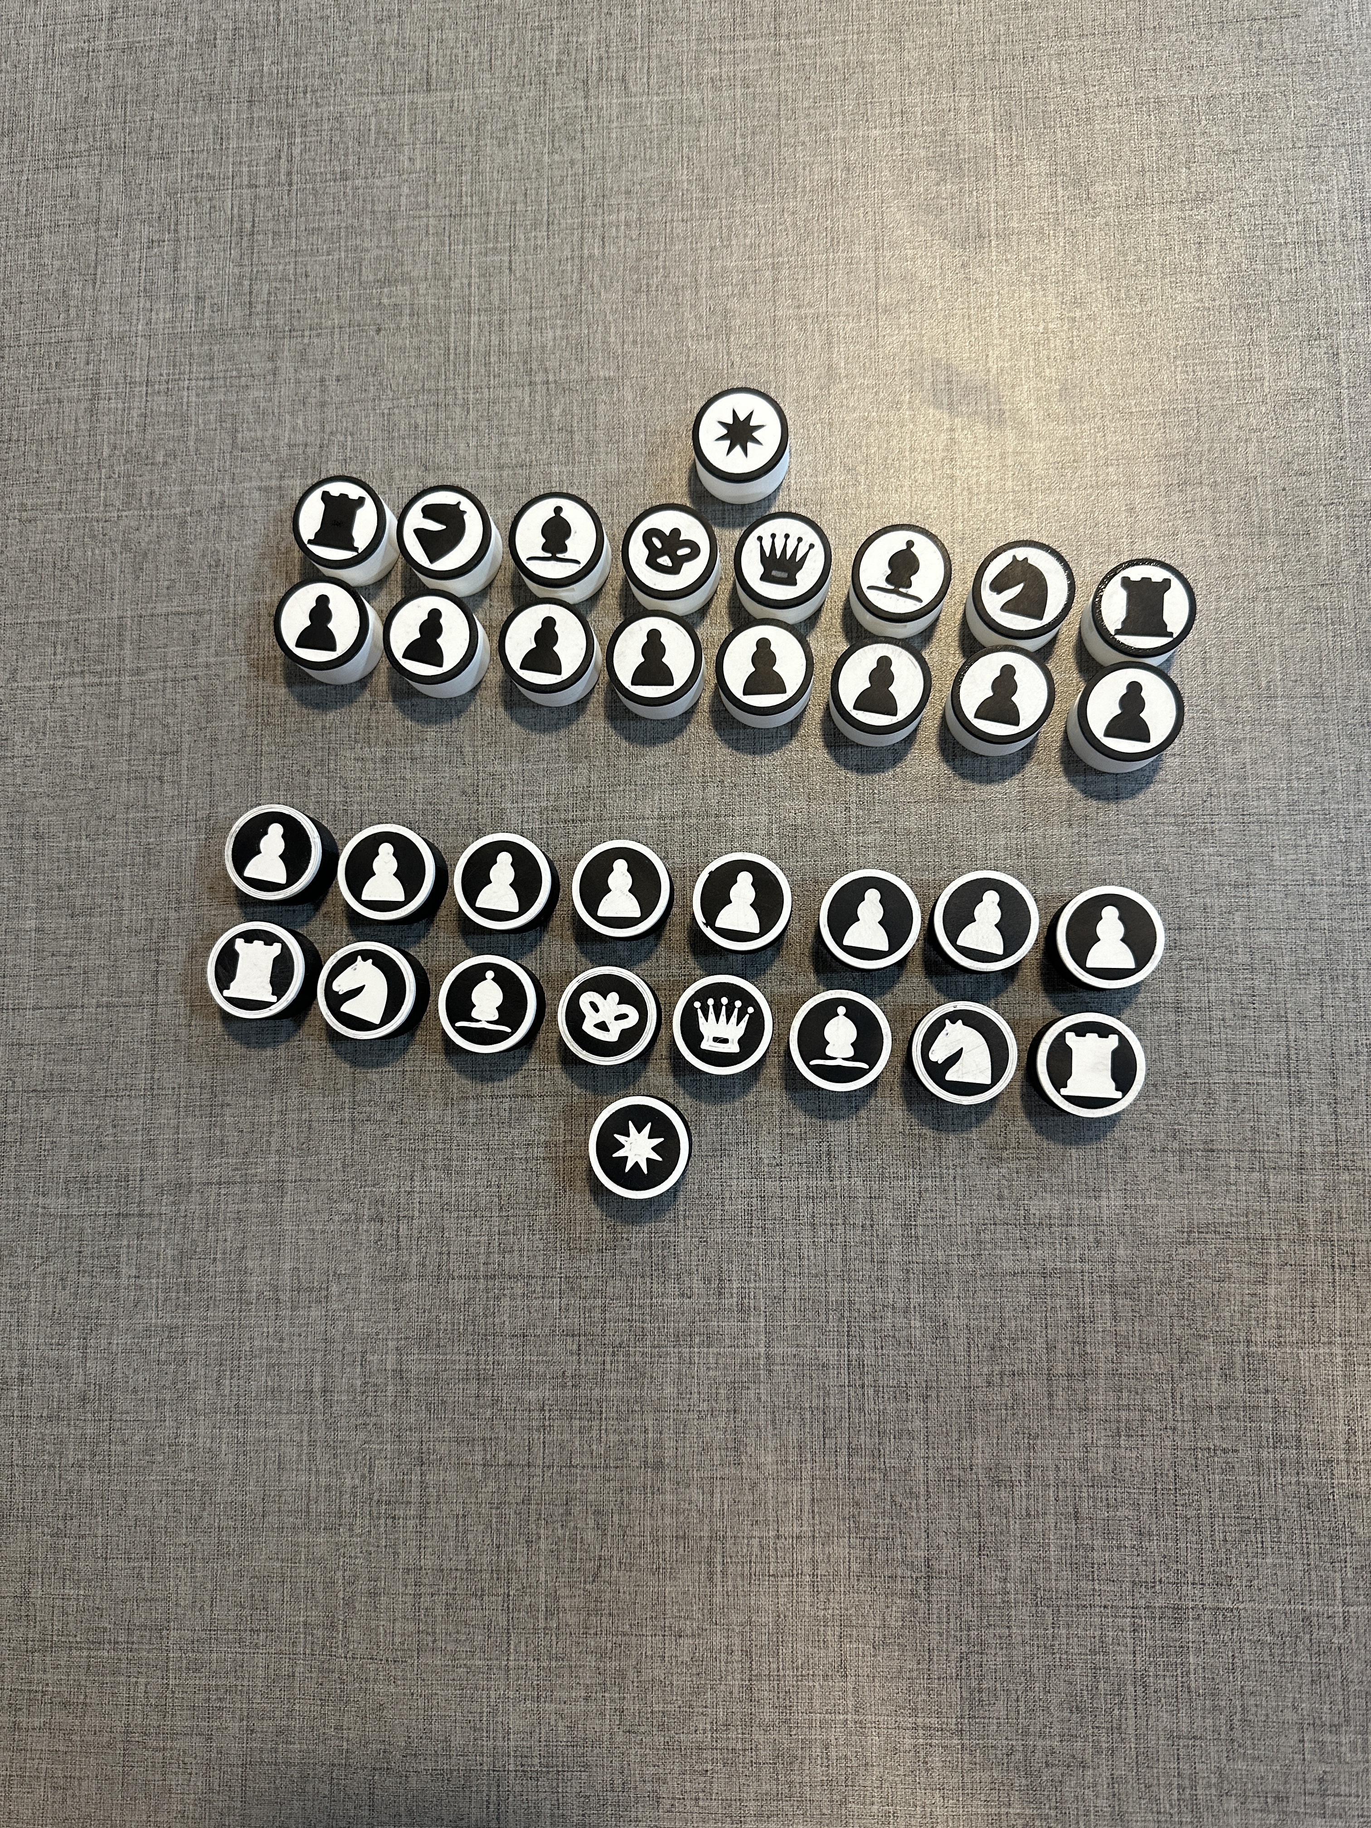
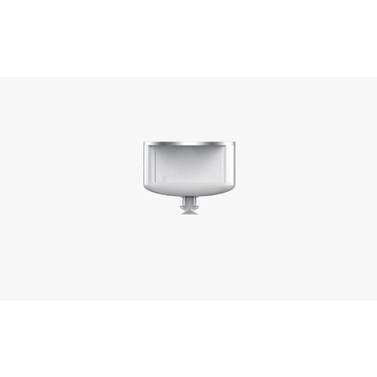
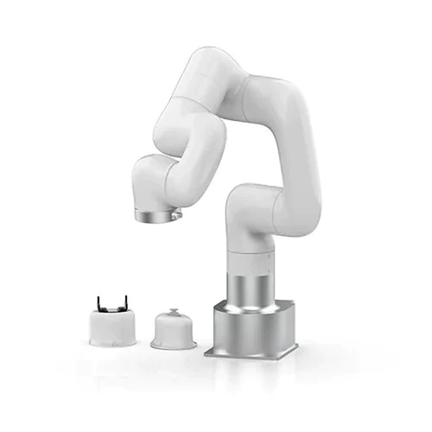
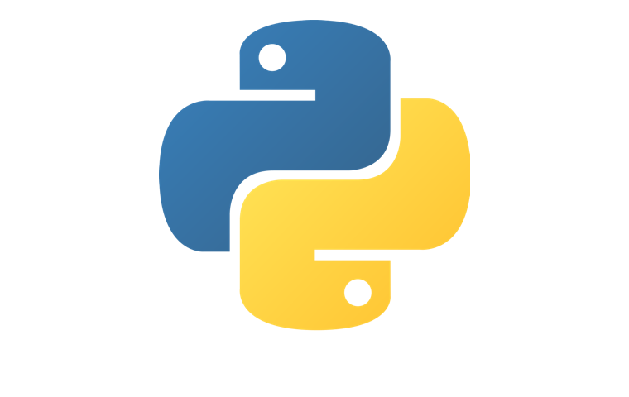
Used Technologies

Slide 5
Used Technologies
Algorithms & Libraries:
xArm python SDK: used to control the robot
Hough Circle: used to detect the chess pieces
Opencv: used to find the board
detectChessboardCorners: used split the board to 8x8 squares
Kivy: used to create GUI
Stockfish: chess engine used to create game logic
3D printer in order to create our pieces
Intel Realsense D435 camera
uFactory xArm lite 6 with vacuum gripper

Slide 6
How it works - Start
Establishing connection to the arm camera.
Detect the board and store the masks for future use(Optional).
Place the pieces on the board.
Choose your difficulty level.
Start the game.

Slide 7
How it works – Game Play
If robot’s turn, get best next move from the engine and command the robot to move accordingly.
Scan the board and check for changes.
If change was detected, check for legality of the move.
If move is legal, commit changes in board. Otherwise notify.
Check game status.
Switch Turn.

Slide 8
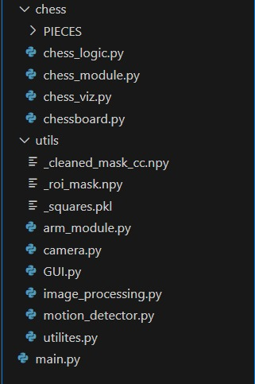
Project Structure

Slide 9
Project Structure - chess
chess_logic.py: responsible for engine and game logic.
chessboard.py: simulating the physical chessboard.
chess_module.py: connects between chess_logic and chessboard.
chess_viz.py: responsible for creating visualization of the game.

Slide 10
Project Structure - utils
arm_module.py: interface for controlling the robotic arm.
camera.py: interface for communication with the camera.
GUI.py: responsible for creating and handling the game UI.
image_processing.py: contains functions for processing and handling frames.
motion_detector.py: responsible for detecting motion in the frame using depth capabilities.
utilities.py: contains general helper functions.

Slide 11
Project Structure - main
main.py: entry point to the project and responsible for connecting all the modules and creating threads for each task.

Slide 12
Summary
We started with almost zero knowledge in Robotics and Computer Vision.
We faced a lot of difficulties, we overcame some and for the rest we found alternative solutions.
We gained a lot of knowledge throughout our work on the project in different fields.
We are looking forward to present our second project and face the challenges we avoided in this one.

Slide 13
Credit
https://github.com/Elucidation/ChessboardDetect/blob/master/README.md
https://github.com/rjgoodloe/ESE205-CVChess
And most importantly, ChatGPT.

Slide 14
For the future
Automatic board detection using object detection.
Automatic board state detection using object detection.
Calibration between robotic arm and camera to avoid fixed-place objects/parameters.
Adding game review after the game is finished to improve game-play.
Automatic pieces setup using the arm.

Slide 15

THANK YOU

